Slide 1
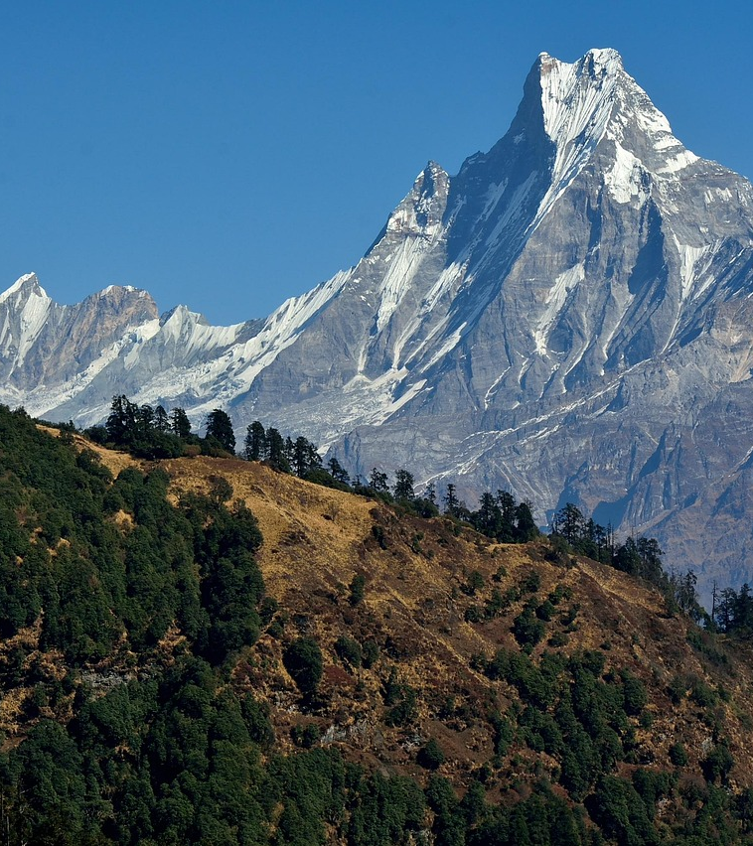
Dashboard of Himalayan Expeditions Data
Presentation
Selly Rizkiyah
RevoU Mini Course - Data Analytics 07 July 2025
Link of Dashboard in Looker: [Tap Here]
Link of Dataset in Sheets: [Tap Here]

Slide 2

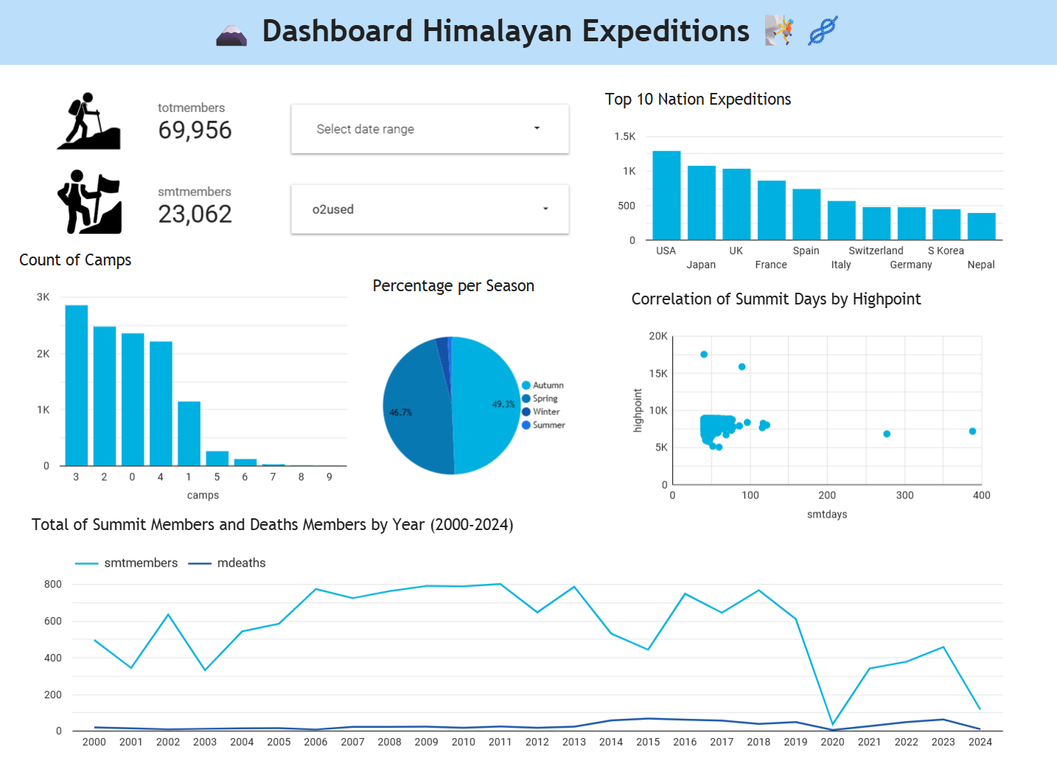
Grafik 1: Top Nation
The USA, Japan and UK have the most expeditions to Nepal, followed by France and Spain. This indicates that Nepal’s mountaineering tourism is driven mainly by these countries, providing opportunities for targeted marketing and partnership strategies to support the tourism sector.
Grafik 2: Total of Summit Members and Death Members by Year (2000-2024)
It can be observed that as the number of summit members increases, the number of deaths remains relatively low, indicating improvements in safety measures, equipment, and guidance in Nepal’s mountaineering activities.

